Slide 1

Which salsa is most sustainable?
Choosing Sustainability
National Sustainability Teachers’ Academy

Slide 2
How do we know if a product is
Sustainable?
National Sustainability Teachers’ Academy

Slide 3
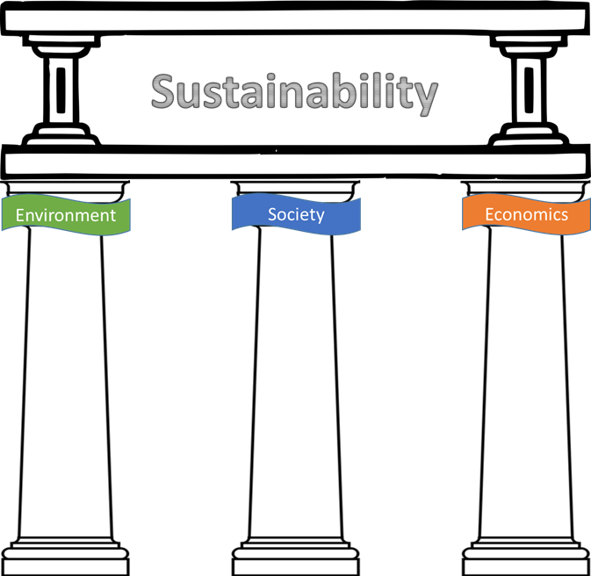
A product is sustainable when it promotes all Three Pillars
National Sustainability Teachers’ Academy

Slide 4
Sustainability Score
Triangle Graph
Economy
0
3
6
Environment
3
Low
0
3
6
High
Society
0
0
3
6
3
3
National Sustainability Teachers’ Academy

Slide 5


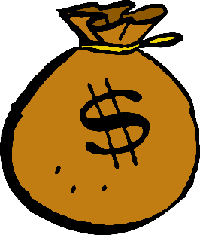
What are possible Trade-offs?
National Sustainability Teachers’ Academy

Slide 6
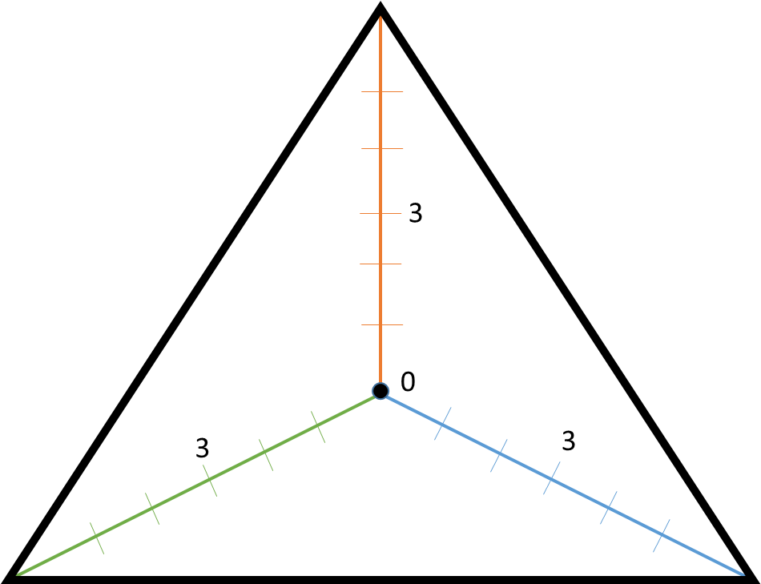
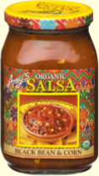
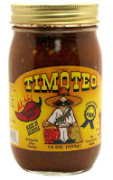
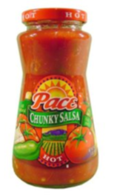
Sustainability of Salsa
National Sustainability Teachers’ Academy

Slide 7
National Sustainability Teachers’ Academy

