Slide 1

Measuring your Ecological Footprint
Resources
National Sustainability Teachers’ Academy

Slide 2

What is your
Ecological
Footprint?
National Sustainability Teachers’ Academy

Slide 3

Can everyone on the
Planet
Live like you do?
National Sustainability Teachers’ Academy

Slide 4
If everyone on the planet lived like a typical American, we would need 4½ Earths to support them all!
National Sustainability Teachers’ Academy

Slide 5


Not everyone has the same Ecological Footprint.
India
China
Costa Rica
France
United States
National Sustainability Teachers’ Academy

Slide 6
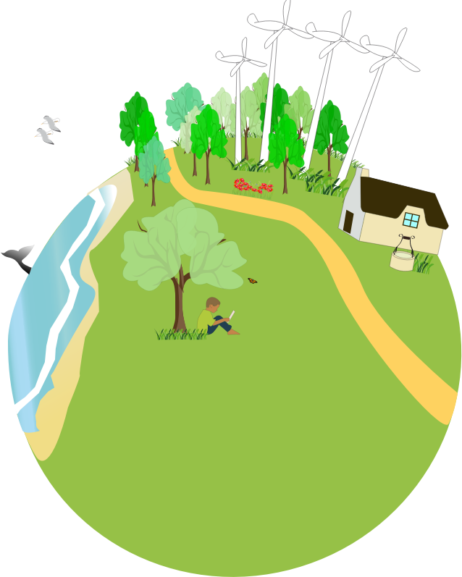
Biocapacity: the ability of the environment to provide the resources we need to live
What are the resources the Earth provides?

Slide 7
Ecological Overshoot: when a population uses more resources than the environment can provide
What happens if the Earth reached Ecological Overshoot?

Slide 8
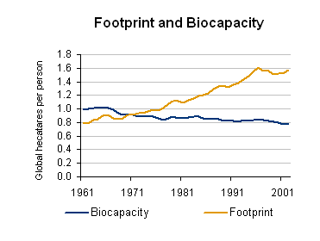
Is China in danger of Ecological Overshoot?
Graph from footprintnetwork.org
National Sustainability Teachers’ Academy

Slide 9


How can we avoid Ecological Overshoot?
Footprint
Time

Slide 10
What can you do
to reduce your
Ecological Footprint?
National Sustainability Teachers’ Academy

Slide 11
National Sustainability Teachers’ Academy

