Slide 1

Sustainability
Think
National Sustainability Teachers’ Academy

Slide 2
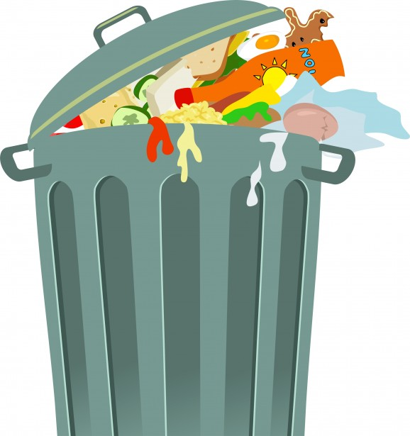
Garbage
Where does the garbage at your school come from?
Try to come up with as many sources as you can.

Slide 3

Energy
What three appliances use the most energy in your house?

Slide 4
Energy
Where does the energy you use come from?
How does it get to your home or school?

Slide 5

Food
Where does your food come from?
Try to trace it back as far as you can.

Slide 6
Food
Obesity rates in the US have increased for the last several decades.
What are the major factors that contribute to obesity in our country?

Slide 7

Water
How does water become polluted?
What are the main sources of water pollution?

Slide 8
Water
700 million people in the world do not have access to clean, reliable drinking water.
Why do you think this is?

Slide 9

Air
Indoor air can be up to 10 times more polluted than outside air.
What are the main sources of indoor air pollution?

Slide 10
Air
How does air quality affect your health?
Is the air cleaner indoors or outdoors?

